Slide 1


TRICS & ATOBETTER:
A PROJECT DELIVERY LIAISON
IAN COLES, PROJECT MANAGER, TRICS CONSORTIUM LIMITED
Notes:
In this presentation I am going to discuss a unique project delivery liaison between TRICS and AtoBetter, which has been ongoing since 2019.

Slide 2

WHAT IS ATOBETTER?
AtoBetter is a Travel Planning project in Norfolk (Norfolk County Council).
AtoBetter has been undertaking travel surveys at numerous new residential developments across the county for a number of years, re-visiting developments over time as sites are built out.
AtoBetter Travel Plans include incentives such as subsidised public transport and cycle equipment vouchers, plus specific cycle events.
Notes:
Before I explain the work that we have done together, it is first best to explain what AtoBetter is. AtoBetter is a Travel Planning project in Norfolk (Norfolk County Council). It has been undertaking travel surveys at numerous new residential developments across the county for a number of years, re-visiting developments over time as these sites are built out. AtoBetter Travel Plans include incentives such as subsidised public transport and cycle equipment vouchers, with specific cycle events also taking place.

Slide 3
ATOBETTER: WHAT IS THE PROJECT ABOUT?
Making travel for residents as easy as possible.
Enabling more journeys at AtoBetter developments to be made by foot, bike, public transport and car sharing.
Working with communities to offer free travel advice and support focused on more active and sustainable ways of getting around.
Fully funded by housing developers through S106 contributions.
Notes:
So, what is the project about? Firstly, it looks to make travel for residents as easy as possible. To do this, the project looks to enable more journeys at AtoBetter developments by sustainable modes, including cycling, walking, public transport and car sharing. It also works with communities to offer free travel advice and support focused on more active and sustainable ways of getting around. All of this is funded by housing developers through S106 contributions.

Slide 4
ATOBETTER: ITS AIMS AND VISION
Aim: To increase the number of journeys made from local sites by alternative modes to the car, by encouraging people to choose healthier, more sustainable travel modes. The project will maximise the travel choices available to residents in order to make sustainable transport options more attractive and a more realistic option for all.
Notes:
What are the aims of AtoBetter, and what is its vision? These two slides provide some insight into this. Firstly, the aim of the project is to increase the number of journeys made from local sites by alternative modes to the car. This can be achieved by encouraging people to choose healthier, more sustainable travel modes. The AtoBetter project seeks to maximise the travel choices that are available to residents, in order to make sustainable transport options more attractive and a more realistic option for everyone.

Slide 5
ATOBETTER: ITS AIMS AND VISION
Vision: Supporting Norfolk County Council’s aims around new and existing communities, ensuring that residential developments deliver measures that allow people and communities to make sustainable travel choices which will improve the quality of life, whilst enhancing the local areas in which they live.
Notes:
The vision of the AtoBetter project can be summed up as follows. It is to support Norfolk County Council’s aims around new and existing communities, to ensure that residential developments deliver measures that allow people and communities to make sustainable travel choices which will improve the quality of life, whilst enhancing the local areas in which they live.

Slide 6
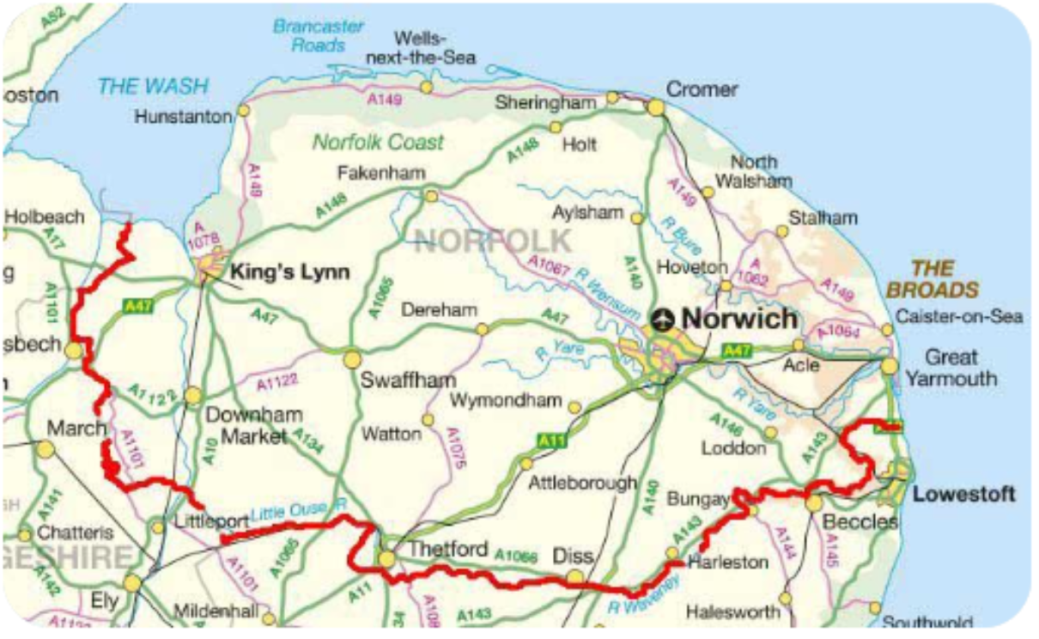
A QUICK BIT ABOUT NORFOLK
Population: 907,760
Area: 5,371 km2
Largest town/city: Norwich
Bordered by coastline and the counties of Suffolk, Cambridgeshire and Lincolnshire.
Notes:
Before we look at the work that TRICS and AtoBetter have been doing together, here is a quick bit about Norfolk. It is a county with a population of around 900,000, with an area of 5,371km2. Its largest city is Norwich, and the county is bordered by coastline plus the three counties of Suffolk, Cambridgeshire and Lincolnshire.

Slide 7
INITIAL IDEAS
In 2018 TRICS were approached to work with AtoBetter to manage and deliver their data collection programme.
A meeting was held to examine survey methodologies and to discuss how AtoBetter surveys could become TRICS-compatible.
It was decided that the Autumn 2019 programme of surveys would be the first that TRICS would work with AtoBetter on.
Notes:
We can move on to the detail of how TRICS and AtoBetter started working together, and it all started in 2018 when TRICS were approached by AtoBetter with a view to managing and delivering their data collection programme. An initial meeting was held in Norwich to examine the differing survey methodologies, and to discuss and work out possibilities as to how AtoBetter surveys could be undertaken in a TRICS-compatible way, which would of course benefit both TRICS and AtoBetter in a number of ways. Once our methodologies were understood and a way forward was worked out, it was decided that the Autumn 2019 programme of surveys would be the first that we would work together on, and work commenced on this basis.

Slide 8
SURVEY METHODOLOGY
AtoBetter required that some surveys were to be traffic-only whilst others were to be multi-modal (to the full TRICS standard).
All construction activity was to be excluded (standard TRICS approach).
It was decided that the vehicle-only surveys would not be split by vehicle type (these would be ATC counts), whilst the multi-modal surveys would follow all TRICS classifications.
Notes:
The AtoBetter project ran in such a way that some surveys at residential developments would need to be traffic-only, whilst others would be multi-modal in nature (to the full TRICS standard). As many of the sites were in the process of being built out through the ongoing programme of surveys, construction activity would need to be identified and excluded from the survey counts. It was also decided that the vehicle-only surveys would not be split by the standard TRICS vehicle classifications (instead these would be directional ATC counts), whilst the multi-modal surveys would include all the standard TRICS vehicle classifications.

Slide 9
SURVEY METHODOLOGY
All surveys would include the TRICS Travel Plan data section.
AtoBetter would work with TRICS data collection contractors to provide supporting information on each development being surveyed, including occupied dwellings at the time of the surveys and estimated breakdowns of dwelling types (privately owned and non-privately owned).
Notes:
For all surveys, regardless of them being vehicle-only or multi-modal, the TRICS Travel Plan data section would always be included, so the Travel Plan features for each development would be included in the TRICS database along with all the other usual data sections as a full record. AtoBetter would work with TRICS-approved data collection contractors to provide supporting information on each development being surveyed, including the number of occupied dwellings at the time of a survey and estimated breakdowns of dwelling types. These breakdowns would include splits between types of houses and flats, and also splits between privately owned and non-privately owned dwellings.

Slide 10
2019 PROJECT SCHEDULE
December 2018: First communications with TRICS.
January 2019: Initial meeting in Norwich.
July 2019: Site visits took place.
August 2019: Survey specifications written and agreed.
September 2019: Surveys took place.
November 2019: Survey data delivered to TRICS.
November 2019: Data input and validation tested.
December 2019: Finalised TRICS outputs forwarded.
Notes:
The first round of surveys were scheduled to take place in September 2019. This allowed plenty of time to get the project started. The first communications had taken place in December 2018, with that initial meeting in Norwich taking place soon afterwards in January 2019. It was important that a firm schedule was set up as soon as possible for all stages of the project, to ensure a smooth transition through the project’s various stages up to the final delivery of the TRICS survey outputs. This meant that site visits would need to take place in July 2019, following the signing of TRICS survey agreements for each development that was to be surveyed. Following these site visits, survey specifications were written up by TRICS and agreed with AtoBetter, which allowed us to then provide quotes for each individual survey. This process took place in August, and once final authorisation was received for the surveys to go ahead, they were all scheduled in to take place over a period two weeks in September. Following the surveys taking place, a great deal of processing was required, before the survey data was forwarded to TRICS for each site on our standard data collection forms at the beginning of November. The TRICS team then worked on data input and validation testing, this process fully completed on time at the beginning of December, allowing the survey data to be included in the TRICS database and the final outputs to be forwarded to AtoBetter.

Slide 11
TRICS ATOBETTER SURVEYS:
SEPTEMBER 2019
20 surveys in total.
9 traffic-only surveys.
11 multi-modal surveys.
Locations included:
  Norwich
  Wymondham
  North Walsham
  Harleston
  Great Yarmouth
  Hunstanton
  Holt
  Aylsham
  Swaffham
Notes:
There were 20 surveys in total in the 2019 programme. These consisted of 9 traffic-only surveys and 11 multi-modal surveys and were across a wide range of locations in Norfolk. This is not a complete list, but some of the towns and cities covered included Norwich, Wymondham, North Walsham, Harleston, Great Yarmouth, Hunstanton, Holt, Aylsham and Swaffham.

Slide 12
2019 TRICS ATOBETTER SURVEY LOCATIONS
Traffic Only
Multi-Modal
Notes:
We can see the survey locations of the 2019 surveys in this map, with a wide range of locations covered in various parts of Norfolk. The blue circles represent the locations of the traffic-only surveys, whilst the red circles represent the locations of the multi-modal surveys.

Slide 13
POST-SURVEY WORK
Survey data was supplied to TRICS on our data collection forms, including all supporting information.
Data was input and put through validation testing, with all validation queries summarised site-by-site.
The data collection contractor worked with AtoBetter to answer queries until each survey was fully validated.
Notes:
As mentioned in a previous slide, the work doesn’t end once the physical surveys take place. For each individual survey, all data fields in the TRICS data collection form needed to be completed, including information on where the site is and local public transport provision, Census information and distances to nearby development types, information on the size of developments and dwellings splits, parking information, and informati0on on the site’s Travel Plan. This, as per all TRICS surveys, requires a significant amount of desktop work. Once all forms had been fully completed, the data was then forwarded to TRICS for input and validation testing. Again, as per all TRICS surveys, all data has to go through a series of checks and tests, with all validation queries raised summarized for each survey and then forwarded to our data collection contractor, who then liaised with AtoBetter accordingly. Once each survey’s validation queries were fully answered, the survey was considered fully validated and became TRICS-certified.

Slide 14
POST-SURVEY WORK
Finalised TRICS outputs and certificates of compliance were issued to close the programme in December 2019.
AtoBetter could then continue to examine changes over time in the survey results.
Plans for future annual data collection programmes would then commence.
Notes:
All TRICS survey outputs and certificates of TRICS survey compliance were issued to close the programme in December 2019. This then allowed AtoBetter to look at the results and compare the data collected through working with TRICS to previous AtoBetter surveys, examining changes in the survey results and mode splits etc over time. Having completed this first programme of surveys, we could then look at future data collection programmes. However, before this, there was another task at hand.

Slide 15
2020: RETROSPECTIVE SURVEYS
In 2020 TRICS were asked to convert older (retrospective) AtoBetter surveys into the TRICS format and link the data to the 2019 surveys.
There were surveys from 2015 to 2018 at numerous developments (all ATC format), which had taken place at the developments surveyed in 2019.
All supporting data needed to be reconciled with the 2019 surveys (in reverse which is unusual – a TRICS time-travel experience!)
Notes:
This additional (and somewhat different) task was to covert older (retrospective) AtoBetter surveys into the new TRICS format, and to link these surveys to the ones carried out in 2019. There had been AtoBetter surveys undertaken from 2015 to 2018 at numerous developments (all in ATC format), which had taken place at the same developments that were surveyed in 2019. This meant that all supporting site, development and parking information needed to be reconciled in a logical way with the 2019 surveys. This involved a process whereby we needed to look at the developments going back in time, which was quite unusual. In fact, you could say this was a TRICS time travel experience! Careful analysis was required to ensure that the build out of the individual developments was reflected in these earlier surveys, as they did not initially include the supporting development information when the 2015 to 2018 AtoBetter surveys had taken place, but through careful examination of development records this process was successfully undertaken, adding a further dimension to the 2019 surveys (in that we could now see changes over time in a unified survey format).

Slide 16
2020 TRICS ATOBETTER SURVEYS
Covid-19 meant that there were only 4 TRICS AtoBetter surveys undertaken in September 2020.
These included a new site in Attleborough. In addition to re-surveying existing developments, new sites also come online and enter the TRICS AtoBetter process.
Notes:
Unfortunately, the intended programme of TRICS AtoBetter surveys for September 2020 had to be drastically reduced due to Covid-19. Only 4 surveys were undertaken in 2020, which included a new development with its first AtoBetter survey in Attleborough . It should be noted that in addition to re-surveying existing developments, new sites also come online and enter the TRICS AtoBetter survey process when certain triggers are hit, this development in Attleborough being one such example, with others to follow later on.

Slide 17
2021 TRICS ATOBETTER SURVEYS
A full programme of TRICS AtoBetter surveys resumed in 2021.
19 surveys in total.
9 traffic-only surveys (now using camera technology).
10 multi-modal surveys.
2 new developments were included in the programme.
The same project schedule as in 2019 was followed (with all validated outputs forwarded in December 2021).
Note that re-surveys were switched between traffic only and multi-modal, a process which continued into the 2022 programme.
Notes:
Thankfully, in 2021 a full programme of TRICS AtoBetter surveys resumed across Norfolk. This was a total of 19 surveys, with 9 being traffic-only (now using camera technology instead of ATC’s) and 10 being multi-modal, 2 of the developments being new to the programme. The same project schedule as per 2019 was successfully followed, with all validated TRICS outputs being forwarded to AtoBetter in December 2021. One thing to note is that re-surveys are usually switched between traffic-only and multi-modal surveys, a process which continued into 2022. This meant that a development that was surveyed as a traffic-only survey in 2019 was in 2021 surveyed as a multi-modal count, and vice versa (taking into account the 4 surveys undertaken in 2020 of course). This switching between survey types was a requirement of AtoBetter, with developments only requiring multi-modal surveys at certain stages of their build out.

Slide 18
2022 TRICS ATOBETTER SURVEYS
A full programme of TRICS AtoBetter surveys continued in 2022.
21 surveys in total.
8 traffic only surveys.
13 multi-modal surveys.
5 new developments were included in the programme.
The same project schedule was followed (with all validated outputs to be forwarded in December 2022).
Notes:
This year’s (2022) programme of TRICS AtoBetter surveys was increased to a total of 21 developments. Of these, 8 were traffic-only surveys and 13 were multi-modal surveys, and 5 developments were new to the programme. The same project schedule is being followed again this year, and all surveys were successfully undertaken in September, with the data currently going through validation testing as I speak. The finalised TRICS outputs will again be forwarded to AtoBetter, along with the certificate of TRICS compliance, in December.

Slide 19
SUMMARY OF SURVEYS TO DATE
(EXCLUDES 2020 RETROSPECTIVE SURVEYS)
Notes:
Here we can see a summary graph of the TRICS AtoBetter surveys to date, with traffic-only surveys shown in blue, multi-modal surveys in orange, an the two types combined in grey. This has been a nice steady stream of surveys to be added to the TRICS database in addition to our annual regional data collection programmes, which of course we are very pleased about.

Slide 20
AN EXAMPLE OF SUCCESSFUL
PROJECT DELIVERY LIAISON
TRICS and AtoBetter is an example of how project delivery liaison can work well.
Once an initial structure was agreed, and through experience in the first (2019) programme, we have adapted and finely-tuned the process.
AtoBetter benefits from the experience of TRICS and its data validation standards, and TRICS benefits from the wealth of data added to its database for all users.
We look forward to this work continuing.
Notes:
This unique project delivery liaison between TRICS and AtoBetter is a great example of how such work can successfully take place. Once we had worked out the initial structure, scale and survey formats of the project the initial 2019 surveys could take place, and this then led to further adaptations and fine-tuning moving forwards into successive survey programmes. Both parties benefit from this joint working approach. AtoBetter benefits from the experience of TRICS and its data validation standards, and TRICS benefits from the wealth of additional data being included in our database which can be accessed all members of the TRICS Community. We certainly look forward to this work continuing.

